Slide 1
NLP Sentiment Analysis DS P534
Varanasi Karthik
Sibasankar Rauta
Chennampalli Lokesh
ANURAG GUNDAPI
BALAJI S
Ruthik Ramchandra Madane
Gautam Sharma

Slide 2
CONTENT
Introduction
Problem Statement
Overview of Dataset
EDA
Data Visualization
Data Preprocessing
Model Building
Models and Evaluation
Model Selection
Deployment
Conclusion

Slide 3
Introduction
Sentiment analysis helps understand customer opinions from textual data.
Widely used in e-commerce platforms to improve product and service quality.
Amazon reviews provide valuable feedback on product satisfaction.
Sentiment analysis extracts emotions or opinions (positive, negative, neutral) from textual data.
It plays a crucial role in opinion mining, social media monitoring, and customer feedback systems.
For businesses like Amazon, it enables large-scale, automated review summarization and classification.
It bridges the gap between customer voice and actionable business intelligence.

Slide 4
Problem Statement
Manual analysis of reviews is time-consuming and inconsistent.
Objective: Build a machine learning model to classify reviews as Positive or Negative.
Goal: Use machine learning and NLP to understand and classify customer feedback in real time
Improve decision-making and user experience with automated sentiment tagging.
With millions of product reviews, manual sentiment interpretation is no longer feasible.
Misinterpreting feedback could lead to poor decision-making or missed market opportunities.
Automating this process enhances scalability, accuracy, and operational efficiency.

Slide 5
Dataset Overview
DataSet: Amazon Alexa reviews (amazon2.tsv).
Total Rows: 3,150 | Columns: 5
Key Features: 'verified_reviews' (text), 'feedback' (1=Positive, 0=Negative).
The dataset is a structured TSV file containing 3,150 entries from verified users.
Reviews are paired with product variations and ratings, providing contextual insights.
Feedback values: 1 denotes a positive sentiment, and 0 denotes a negative sentiment.
This binary classification forms the target variable for our ML model.

Slide 6
EDA
Analysing distribution of sentiment labels.
Generated word clouds for both Positive and Negative reviews.
Identified frequently used keywords per sentiment class.
The majority of reviews are positive, indicating product acceptance.
Visualized term frequencies with word clouds and bar charts to distinguish sentiment tone.
Example: Positive reviews often contained words like “love”, “easy”, “great”; negatives had “poor”, “return”, “issue”.
Such patterns help verify that text features hold predictive value.

Slide 7
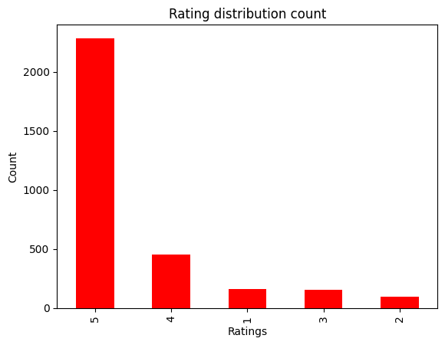
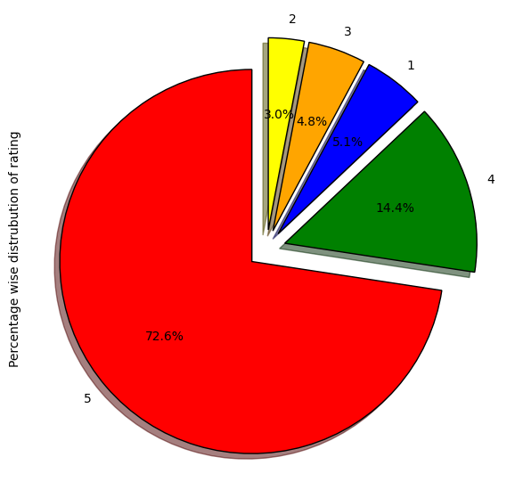
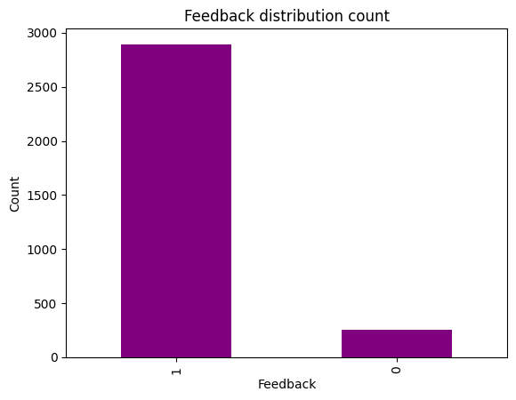
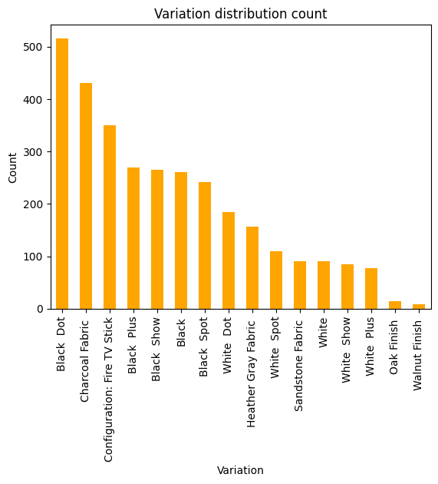
Data Visualization

Slide 8
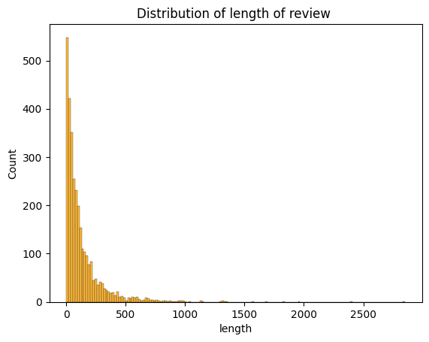
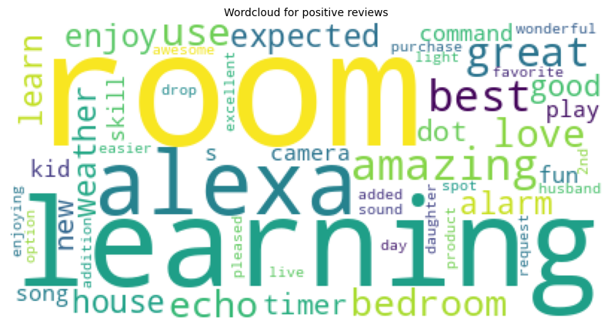
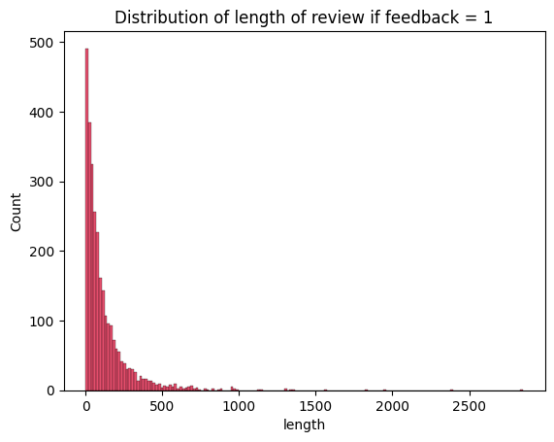
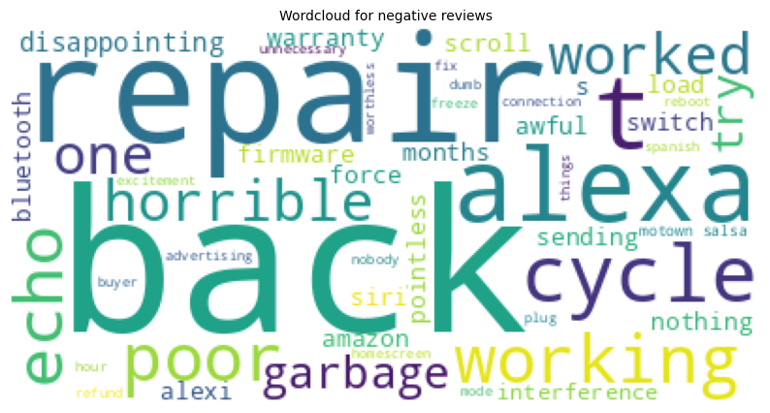

Slide 10
Data Preprocessing
Text normalization steps include lowercasing, punctuation removal, and stemming
Stop words like “the”, “is” “and” are removed to retain meaningful terms.
Used Porter Stemmer to reduce words to root form.
Used TF-IDF Vectorization to weigh important terms higher than frequent but less informative once.
Preprocessing is crucial to improve feature quality and model performance
As the data set is Unbalanced set SMOT is used for stability of data

Slide 11
Model Building
Train-test split used to validate model performance.
Feature extraction via TF-IDF.
Models used: Random Forest, XGBoost, Decision Tree and other.
Data was split into training and testing sets to prevent overfitting.
TF-IDF helped in dimensionality reduction while preserving context.
All ML models were tested: Decision Tree, Random Forest,XGBoost and other.
Hyperparameter tuning was applied, where necessary to optimize accuracy.

Slide 12
Model Evaluation
Metrics: Accuracy, Precision, Recall, F1-score.
Used confusion matrix to analyze predictions.
Cross-validation to ensure generalization.
Evaluation metrics go beyond accuracy — precision, recall, and F1-score reveal the full performance.
Confusion matrix showed the model's ability to handle both classes.
XGBoost performed best in capturing the nuances of imbalanced data.
Stratified K-fold cross-validation ensured stable model behavior across different data splits.

Slide 13
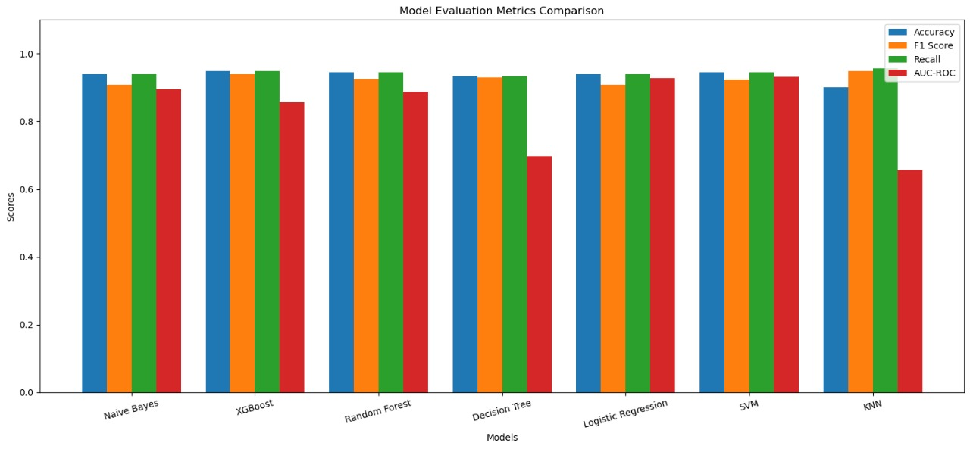
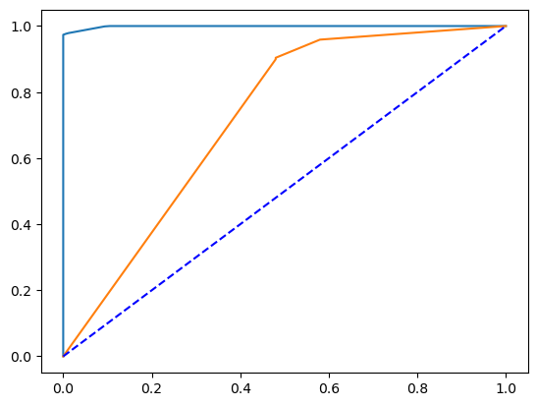
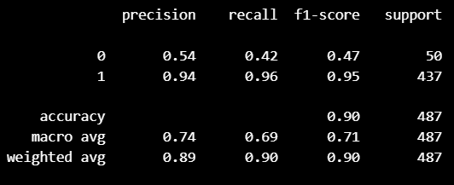
Classification Report
ROC CURVE

Slide 14
Classification Report
ROC CURVE

Slide 15
Best Model Selection
Decision Tree Classifier showed highest accuracy and robustness.
Successfully classified sentiments with over 90% accuracy.
Well-balanced results across metrics.
Decision Tree reached over 90% accuracy and had high F1-score on both classes.
Its ability to focus on hard-to-classify instances improved the model’s generalization.
Feature importance analysis showed key terms contributing to sentiment classification.
The model can be deployed to analyze reviews in real-time with minimal lag.

Slide 16
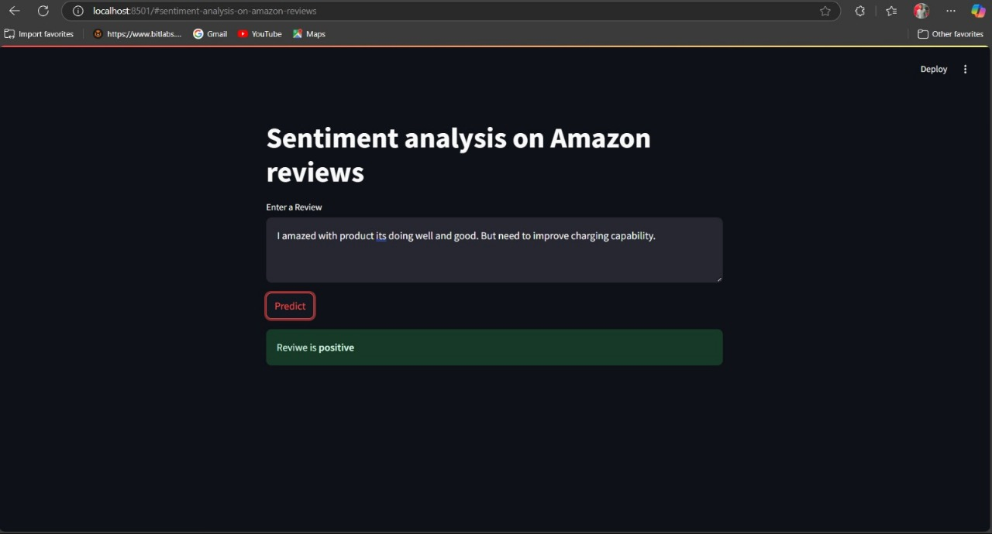
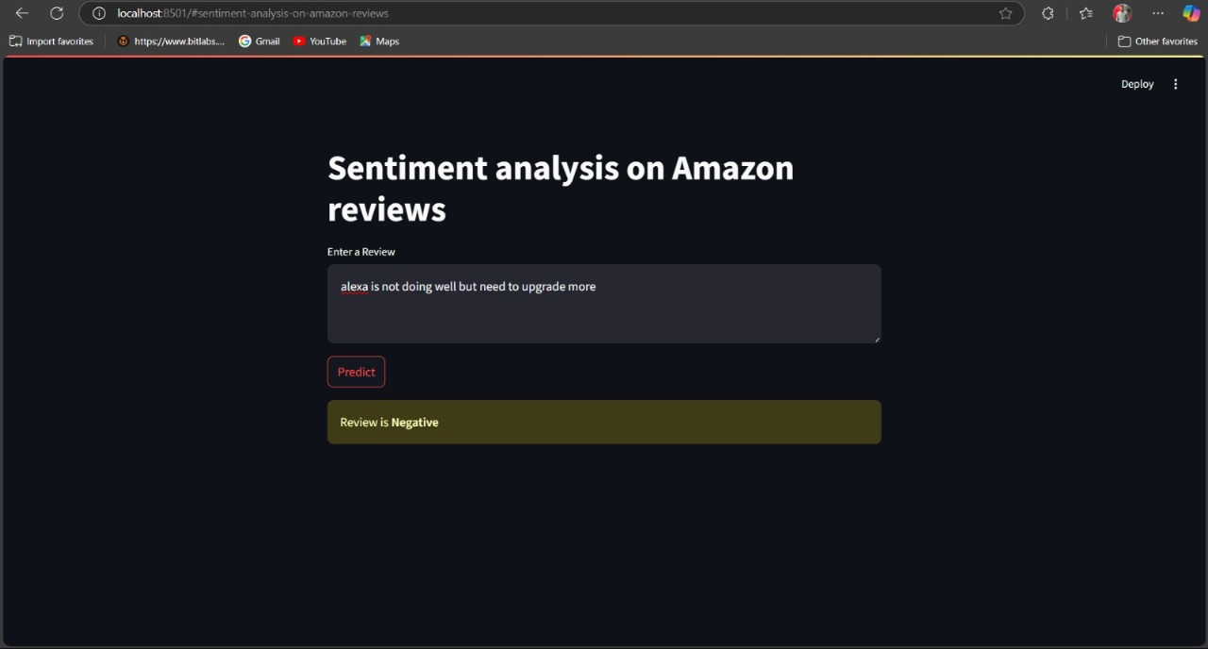
Deployment of Model
Source file is converted into Pickle file and then Model is Deployed through stream lit Application for client easiness.
The Input need to be given in and Output displays on screen

Slide 17
Conclusion
Sentiment analysis achieved strong performance with classical ML models.
Model can support real-time customer feedback systems.
This project successfully applied classical machine learning techniques to perform sentiment analysis on Amazon product reviews with high accuracy.
Text preprocessing steps such as tokenization, stop word removal, and TF-IDF vectorization significantly contributed to model performance.
Among the models used, Decision Tree classifier delivered the most robust and accurate results, with over 90% accuracy, proving its effectiveness in handling classification problems with text data.
The confusion matrix and evaluation metrics confirm the model's reliability in identifying both positive and negative reviews.
This sentiment analysis system can be integrated into real-world applications to help businesses make data-driven decisions and improve customer satisfaction.

Slide 18
Contributions
Pre-Processing And EDA : 1. Ruthik Ramchandra Madane
2. BALAJI S
Model Building And Evaluation : 1. Gautam Sharma
2. ANURAG GUNDAPI
Deployment and UI Script : 1.Lokesh Reddy Chennampalli
2. Varanasi Karthik
Presentation:(Content, Preparation 1. Sibasankar Rauta
And Editing.) 2. Varanasi Karthik
3.Lokesh Reddy Chennampalli

Slide 19
THANK YOU

